Slide 1
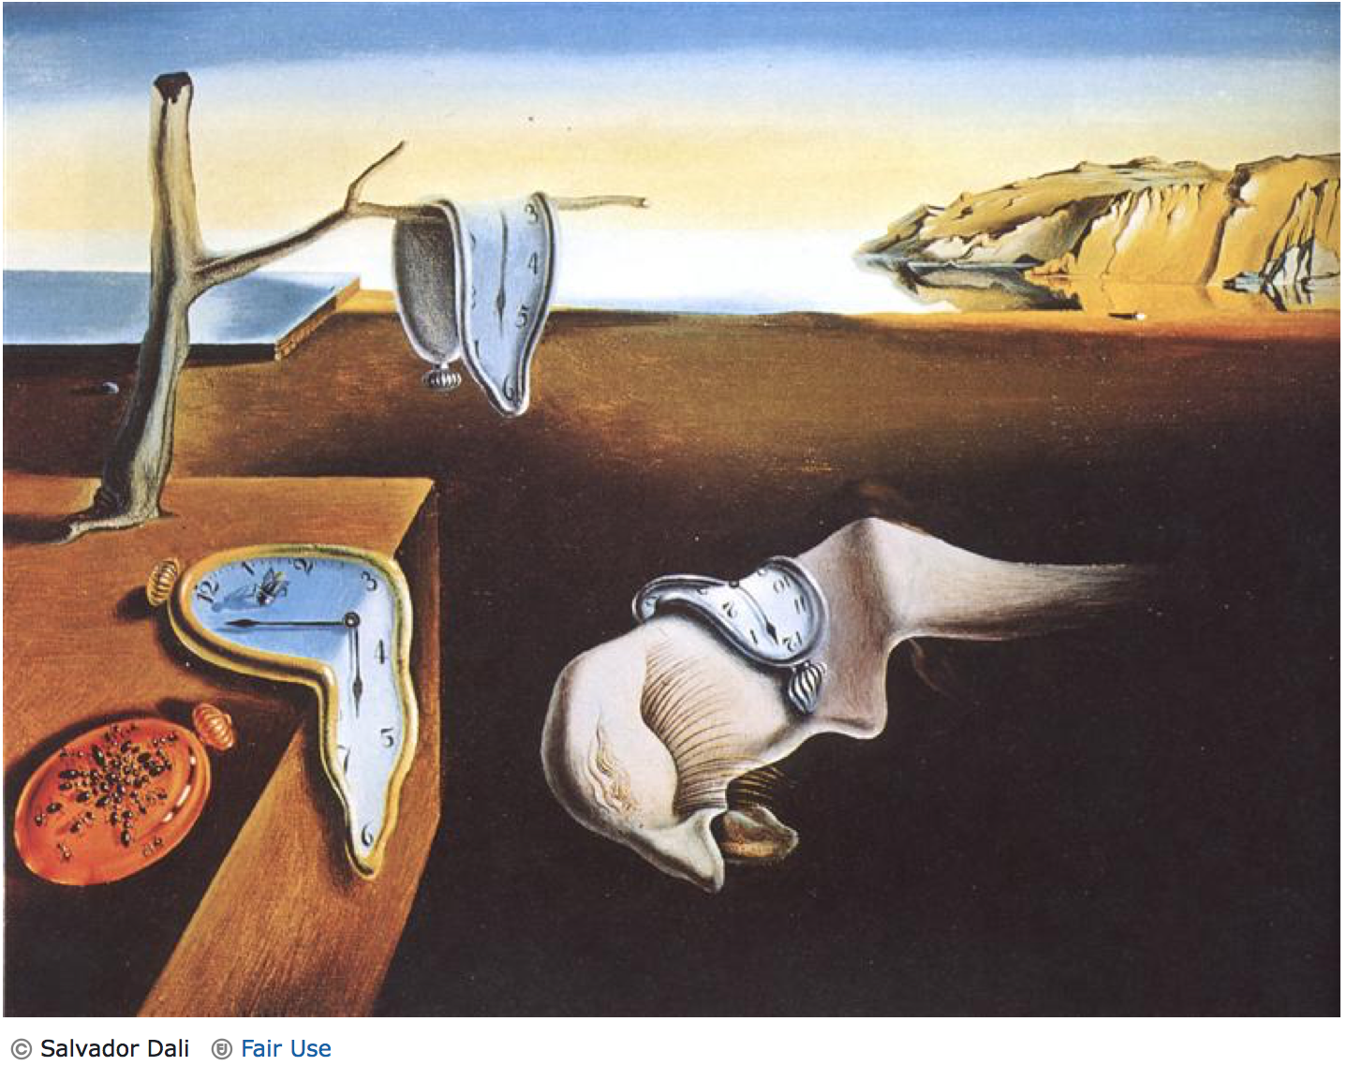
Molecular Clocks, Gene Trees and Species Trees
Slatteryjp@si.edu
Jill.Pecon-Slattery@colostate.edu
www.cornerstonegenomics.com
https://gdwworkshop.colostate.edu

Slide 2
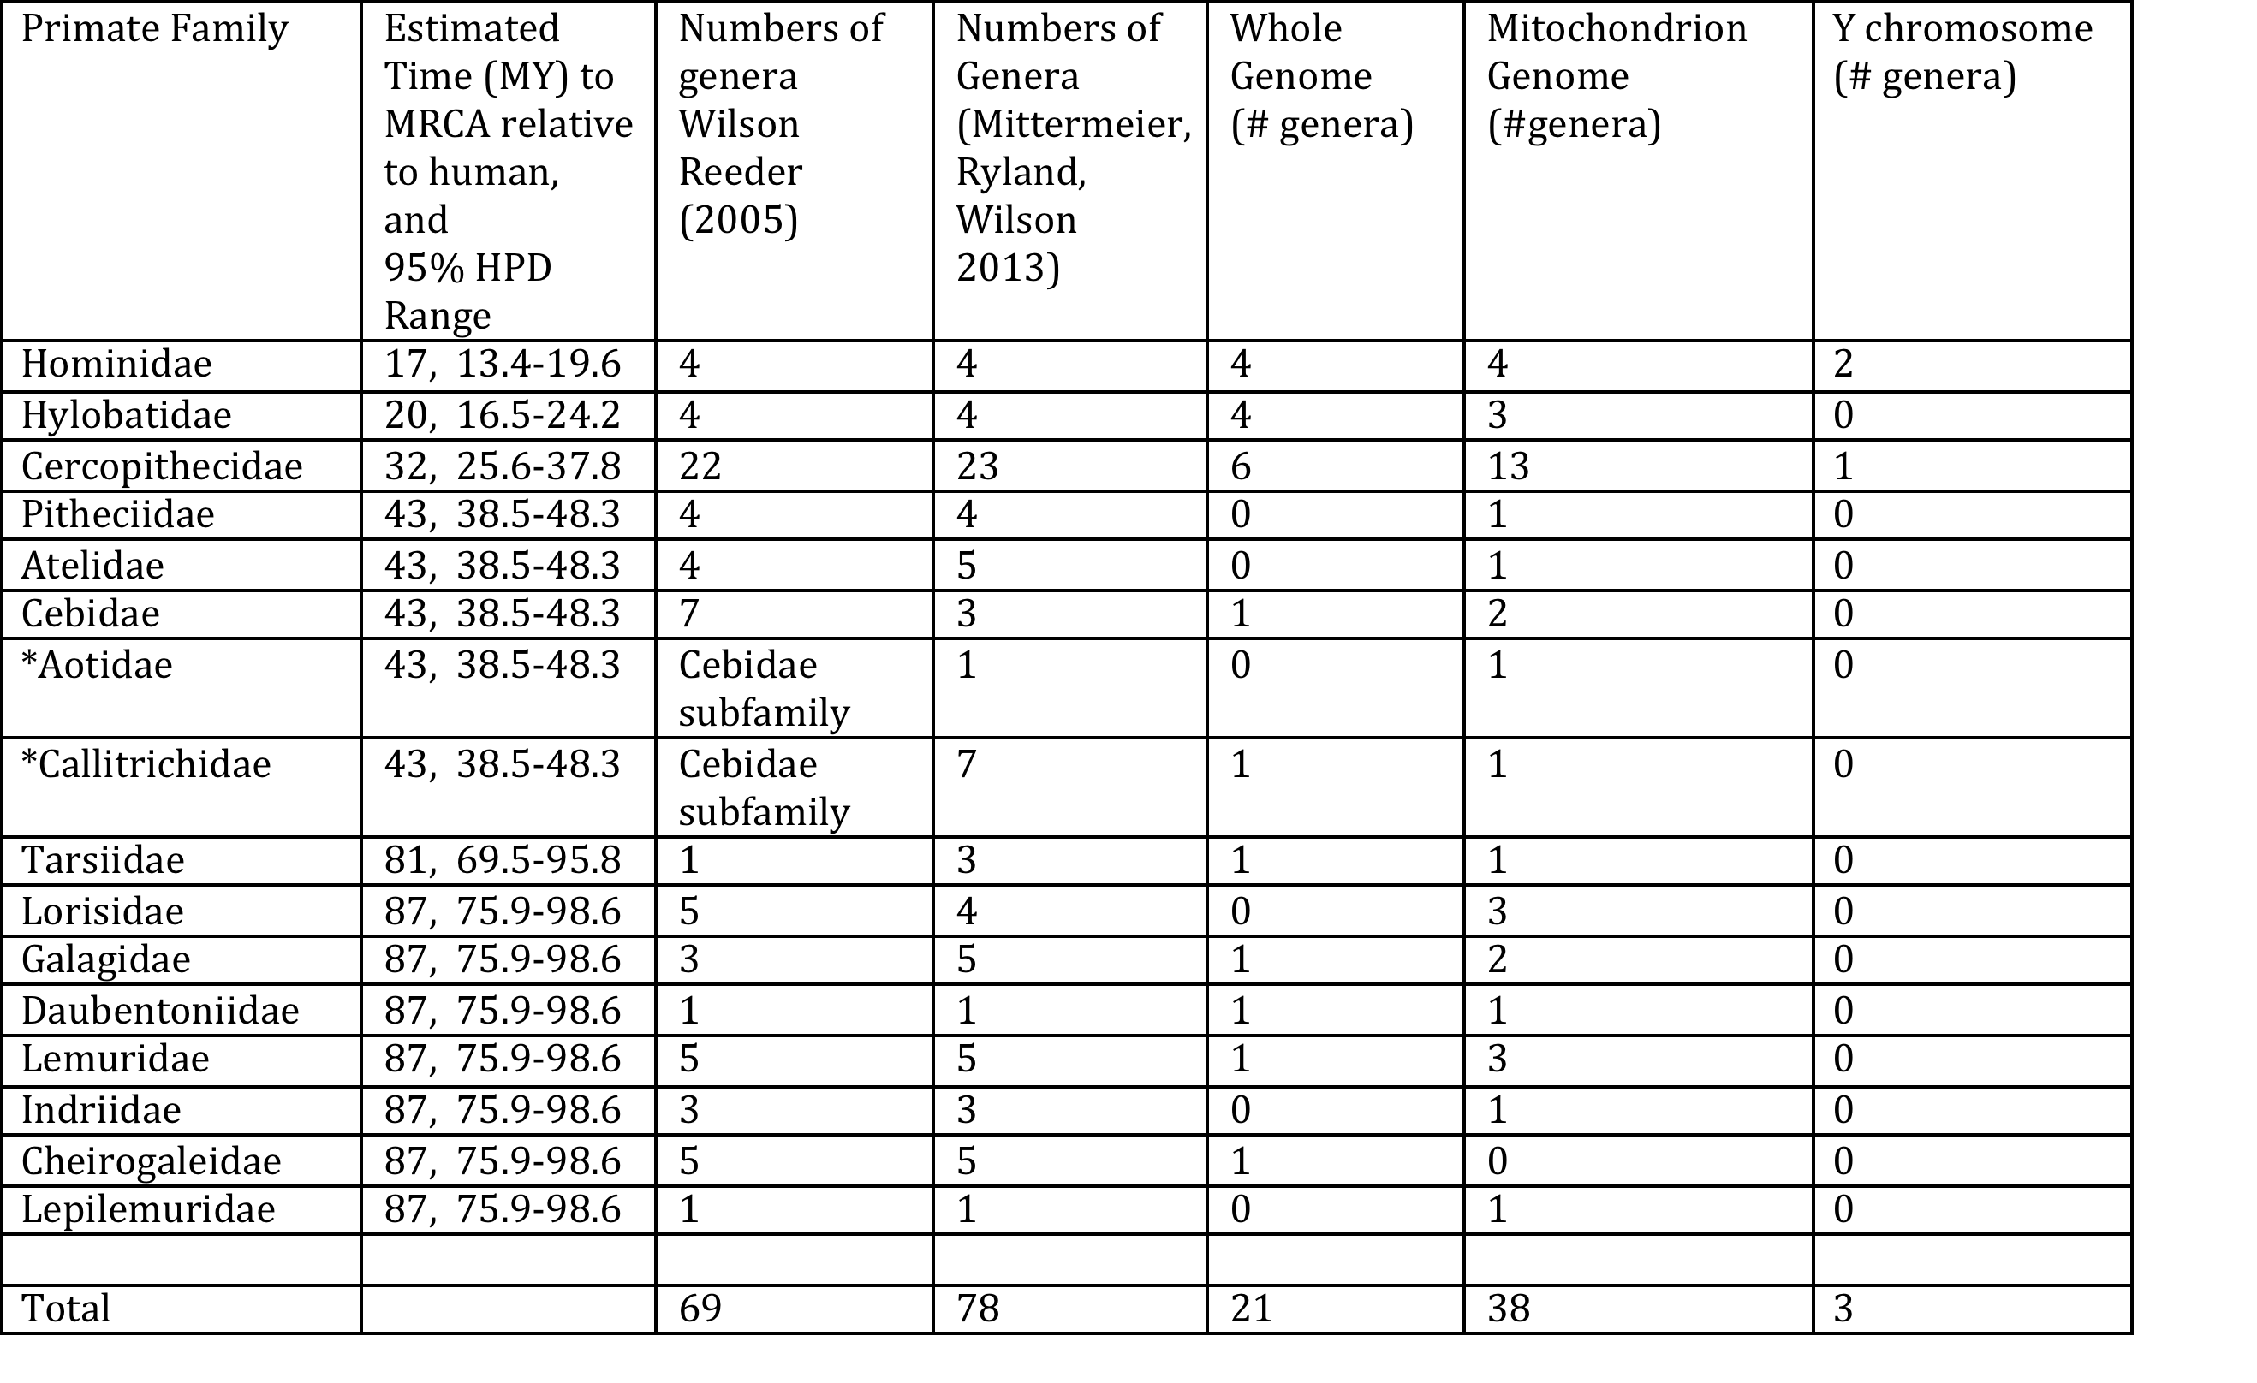
Estimation of TMRCA

Slide 3
Advances in Molecular Dating Methods
Notes:
Strict

Slide 4
Definitions
Gene tree-genealogical history of the gene or gene family over time.
Species tree-genealogical relationships of species from which genes were sequenced
Molecular Clock-genetic divergence is roughly proportional to evolutionary time
Concatenation methods-A single sequence per taxon that is a composite of multiple gene regions selected across the genome.
Incomplete lineage sorting-evolutionary history of genes are discordant with patterns of speciation.
Multi-Species Coalescent methods-individual gene trees are simultaneously or separately estimated and then a summation method to ascertain phylogenetic relationships.
Notes:
.

Slide 5
Strict Molecular Clock
The hypothesis that the rate of molecular evolution is constant over time or among species. Thus, mutations accumulate at a uniform rate after species divergence, keeping time like a timepiece.

Slide 6
Relaxed Molecular Clock and Bayesian Methods
Models of evolutionary rate drift over time or across lineages developed to relax the molecular clock hypothesis.
The parameters are the species divergence times (t) and the evolutionary rates (r) within a Bayesian model.

Slide 7
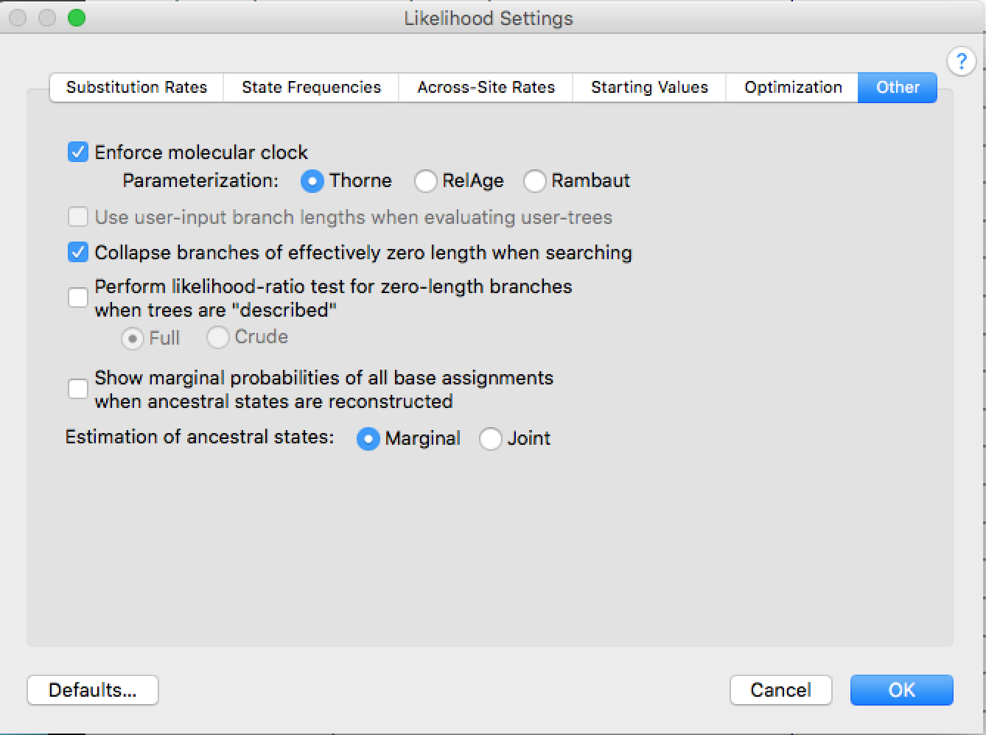
PAUP: Create phylogeny with and without Molecular Clock enforced, compare lnLikelihoods

Slide 8
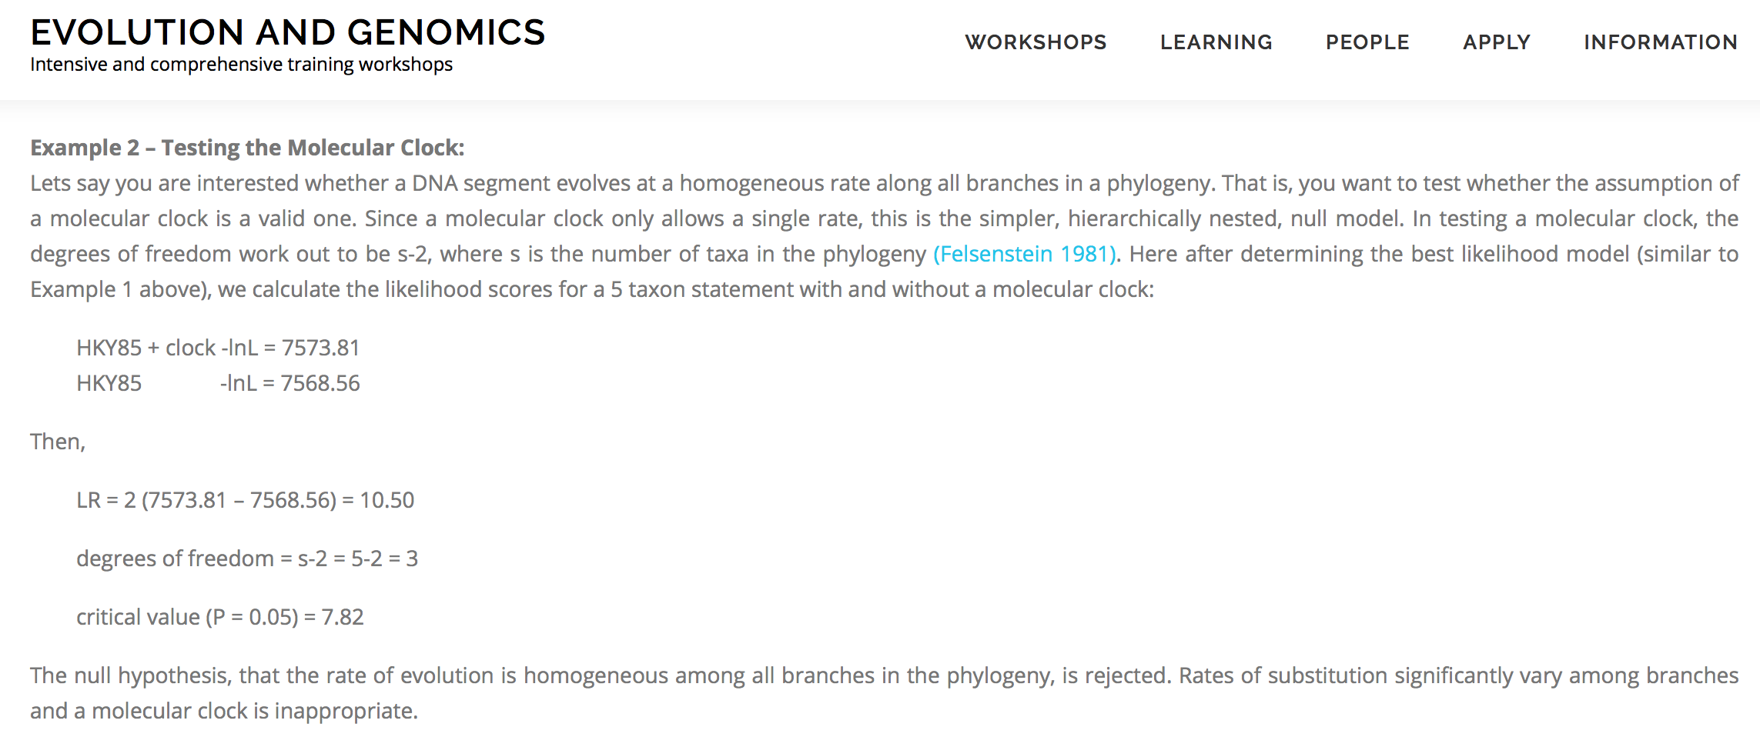
Phylogenetics: Testing the Clock

Slide 9
Time-Tree: Dating Nodes Within Molecular Genomic Phylogeny
Testing for Molecular Clocks
Strict: substitution rate the same for all branches of topology
Relaxed: Heterogeneous substitution rates are permitted with different branches of topology
Time-Tree estimation with Bayesian framework is computationally prohibitive with large scale genomic sequence data
Solution is to select subsets of data
genes, species or both
Codon position (1st and 2nd)
Hierarchical lineages within phylogeny
Assess sample strategy by testing for consistent rates across lineage
Calibration: Multiple fossil record (host) or known date(s) linked with pathogen
Iterative subsampling to converge on dates for nodes

Slide 10
Bayesian Programs to Estimate Molecular Clock

Slide 11
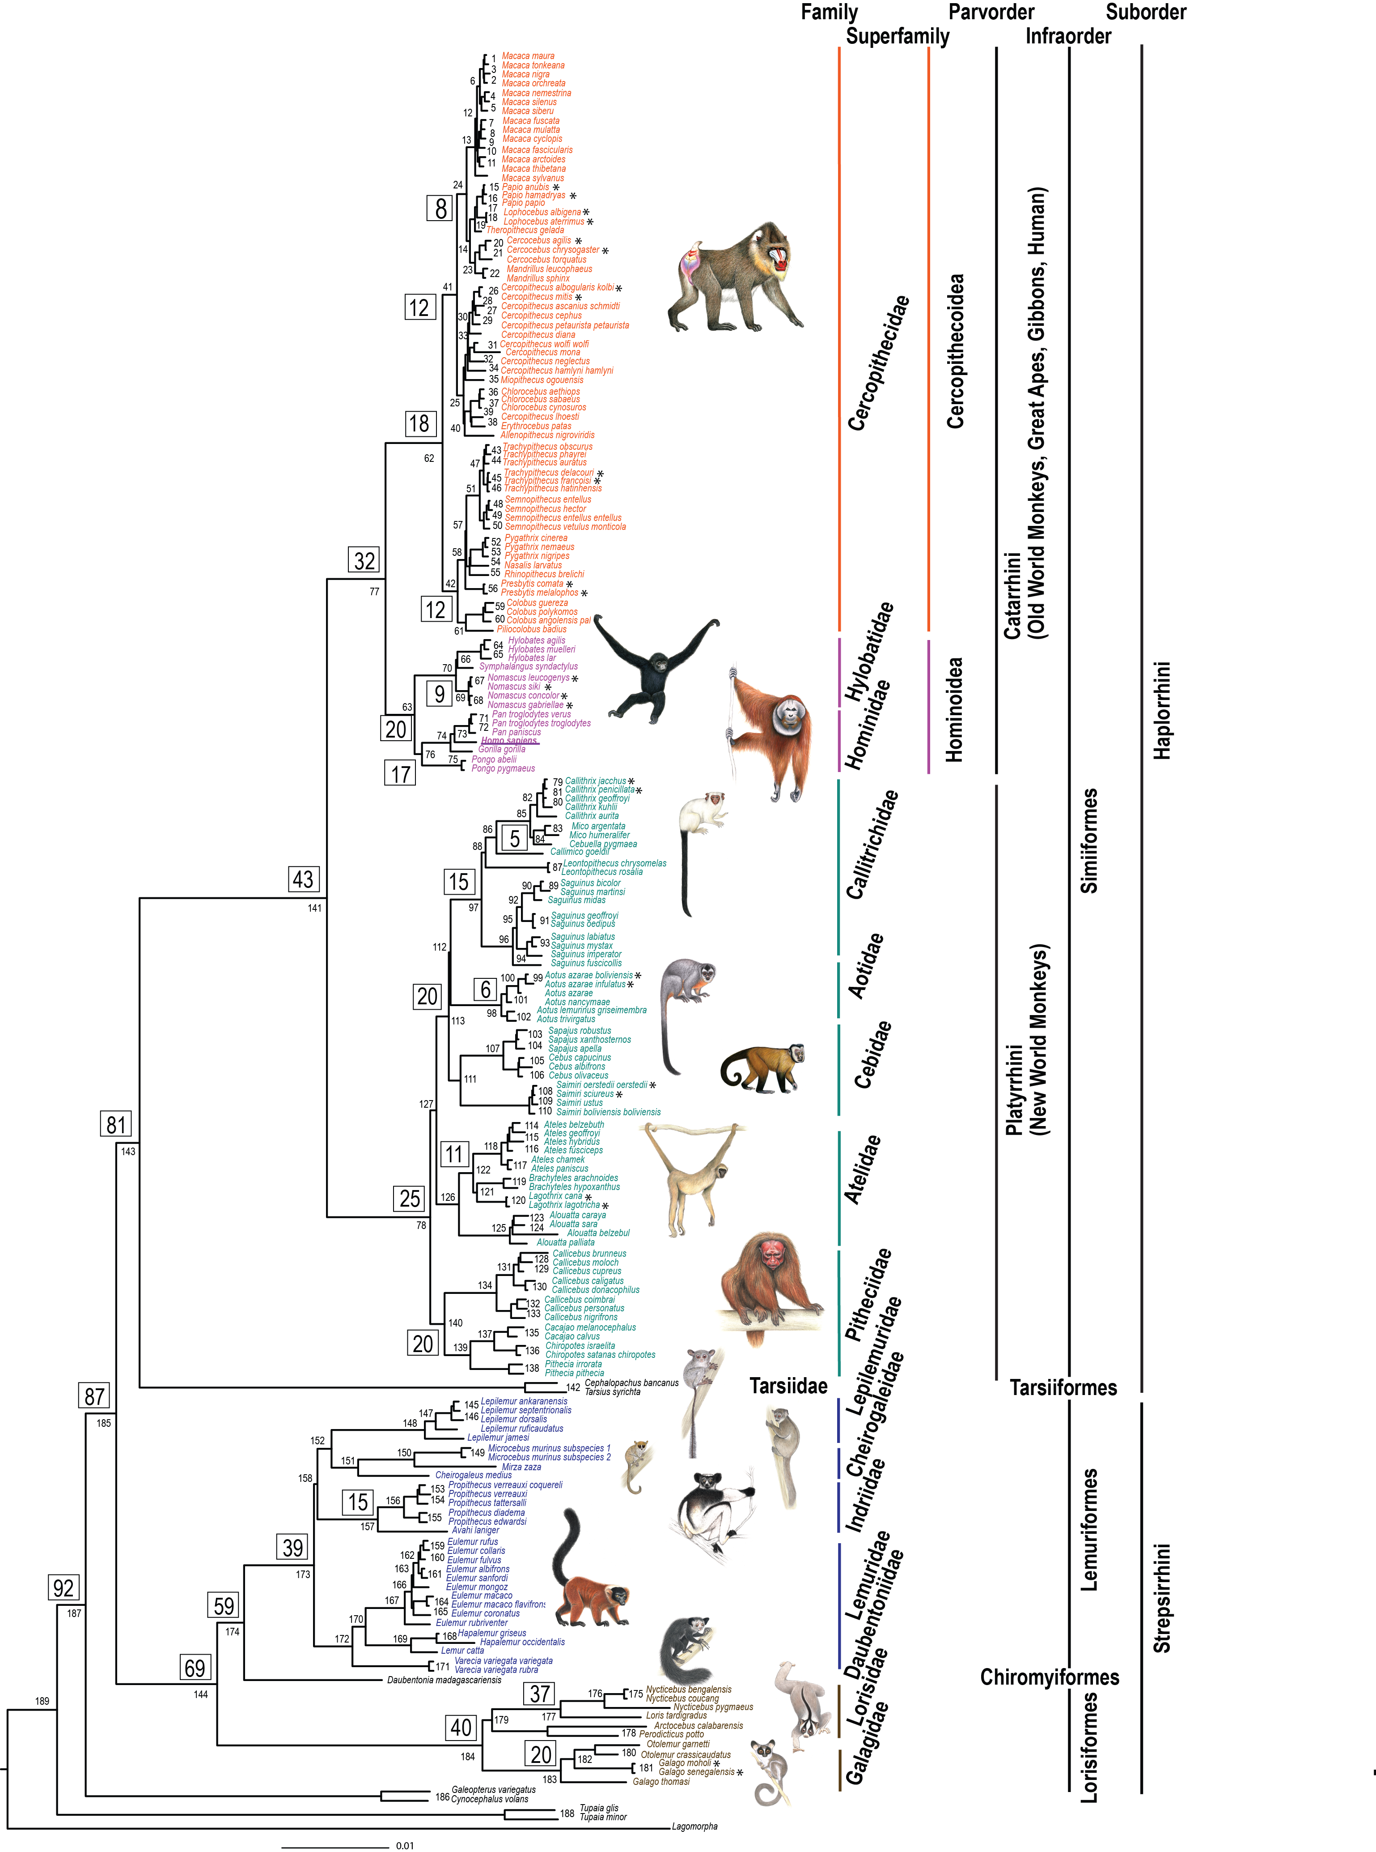
DATING NODES (BEAST)
Calibrated by fossil record: Strong support from consensus of paleoanthropologist with extensive citation record per dates
A Galigidae-Lorisidae split 38-42 MYA
B Simiiformes 36-50 MYA
C Catarrhini 20-38 MYA
D Platyrrhini 20-27 MYA
E Papionini 6-8 MYA
F Theropithecus 3.5-4.5 MYA
G Hominidae 13-18 MYA
H Homo-Pan split 6-7 MYA
5 Different Sets Of Species (BEAST):
1) Genus-level data set including 61 Primate genera, two Dermoptera genera and one Scandentia genus rooted by Lagomorpha,
2) Catarrhini species with outgroups,
3) Platyrrhini species with outgroups,
4) Strepsirrhini species with outgroups and
5) Genus-level analysis with a partitioned data set allowing for rate heterogeneity and different substitution models for autosome, X-chromosome, and Y-chromosome sequences.

Slide 12
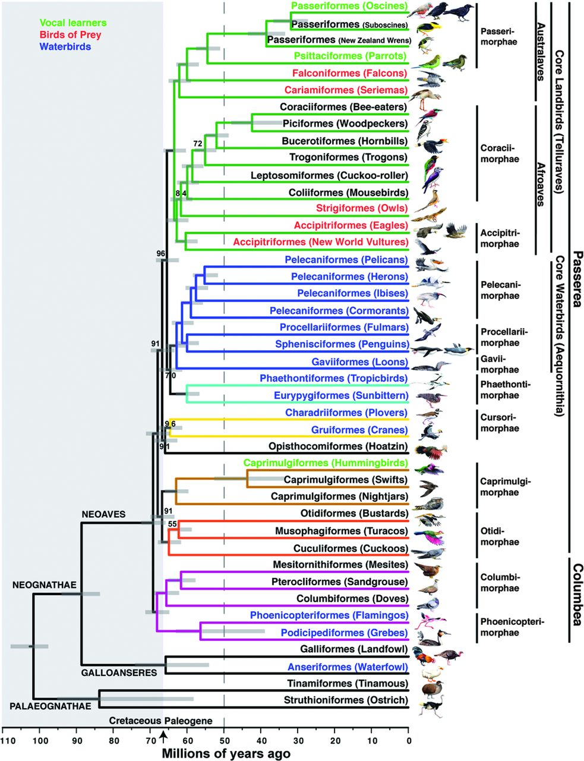
Selection Criteria
39 Fossil Calibration Points
Increases from root, oldest to youngest
Literature reference, citation, supporting documentation
Taxonomic description
Stratigraphic range of fossil taxon
Parts of skeleton used for fossil date
Erich D. Jarvis et al. Science 2014;346:1320-1331

Slide 13
Pathogen Genome Evolutionary Rates
Absence of pathogen fossils for calibration
In general, the longer the residence time within host population or species, the greater the evolutionary divergence among strains.
Should take into account that greater the evolutionary time interval, the greater the opportunity for purifying selection, site saturation (multiple hits),to limit diversity (approaches the asymptote)

Slide 14
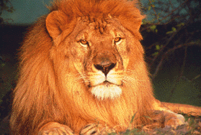
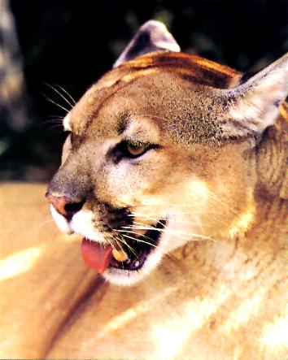
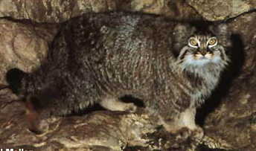
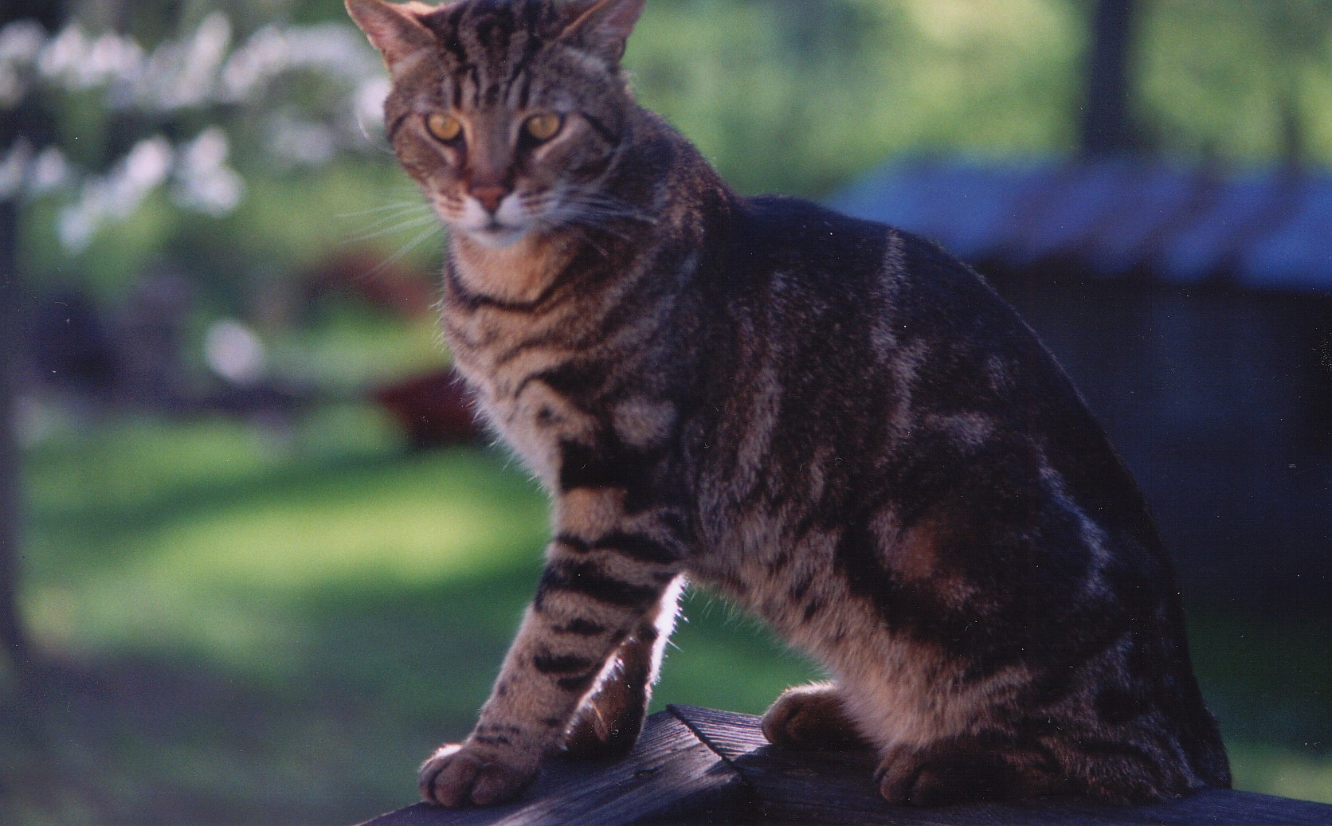
Divergence estimates across FIV genome reveal unequal rates, selection, and recombination
Pecon-Slattery et al 2008. BMC Genomics 9:66

Slide 15
Incomplete Lineage Sorting (ILS)
Incomplete lineage sorting occurs when gene trees do not reflect true species phylogeny (reciprocal monophyly). The genes, due to biological processes such as inter-species hybridization, introgression, reticulate evolution, or molecular processes (i.e mutation rate, recombination, or genome function), provide alternate topologies.
Characteristic in radiations characterized by short internal internode distances correlated with rapid diversification.
Usually nodes are weakly supported (<70%) with bootstrap values or Bayesian proportions (<0.9)
Concatenation studies tend to ignore these genes alternate topologies as it generates too much ‘noise’ or homoplasy (convergent, reversal, multiple hits)
However, recent studies particularly with humans and great apes indicate that these gene may have functional implications important in understanding species biology and/or adaptive evolution

Slide 16
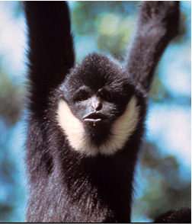
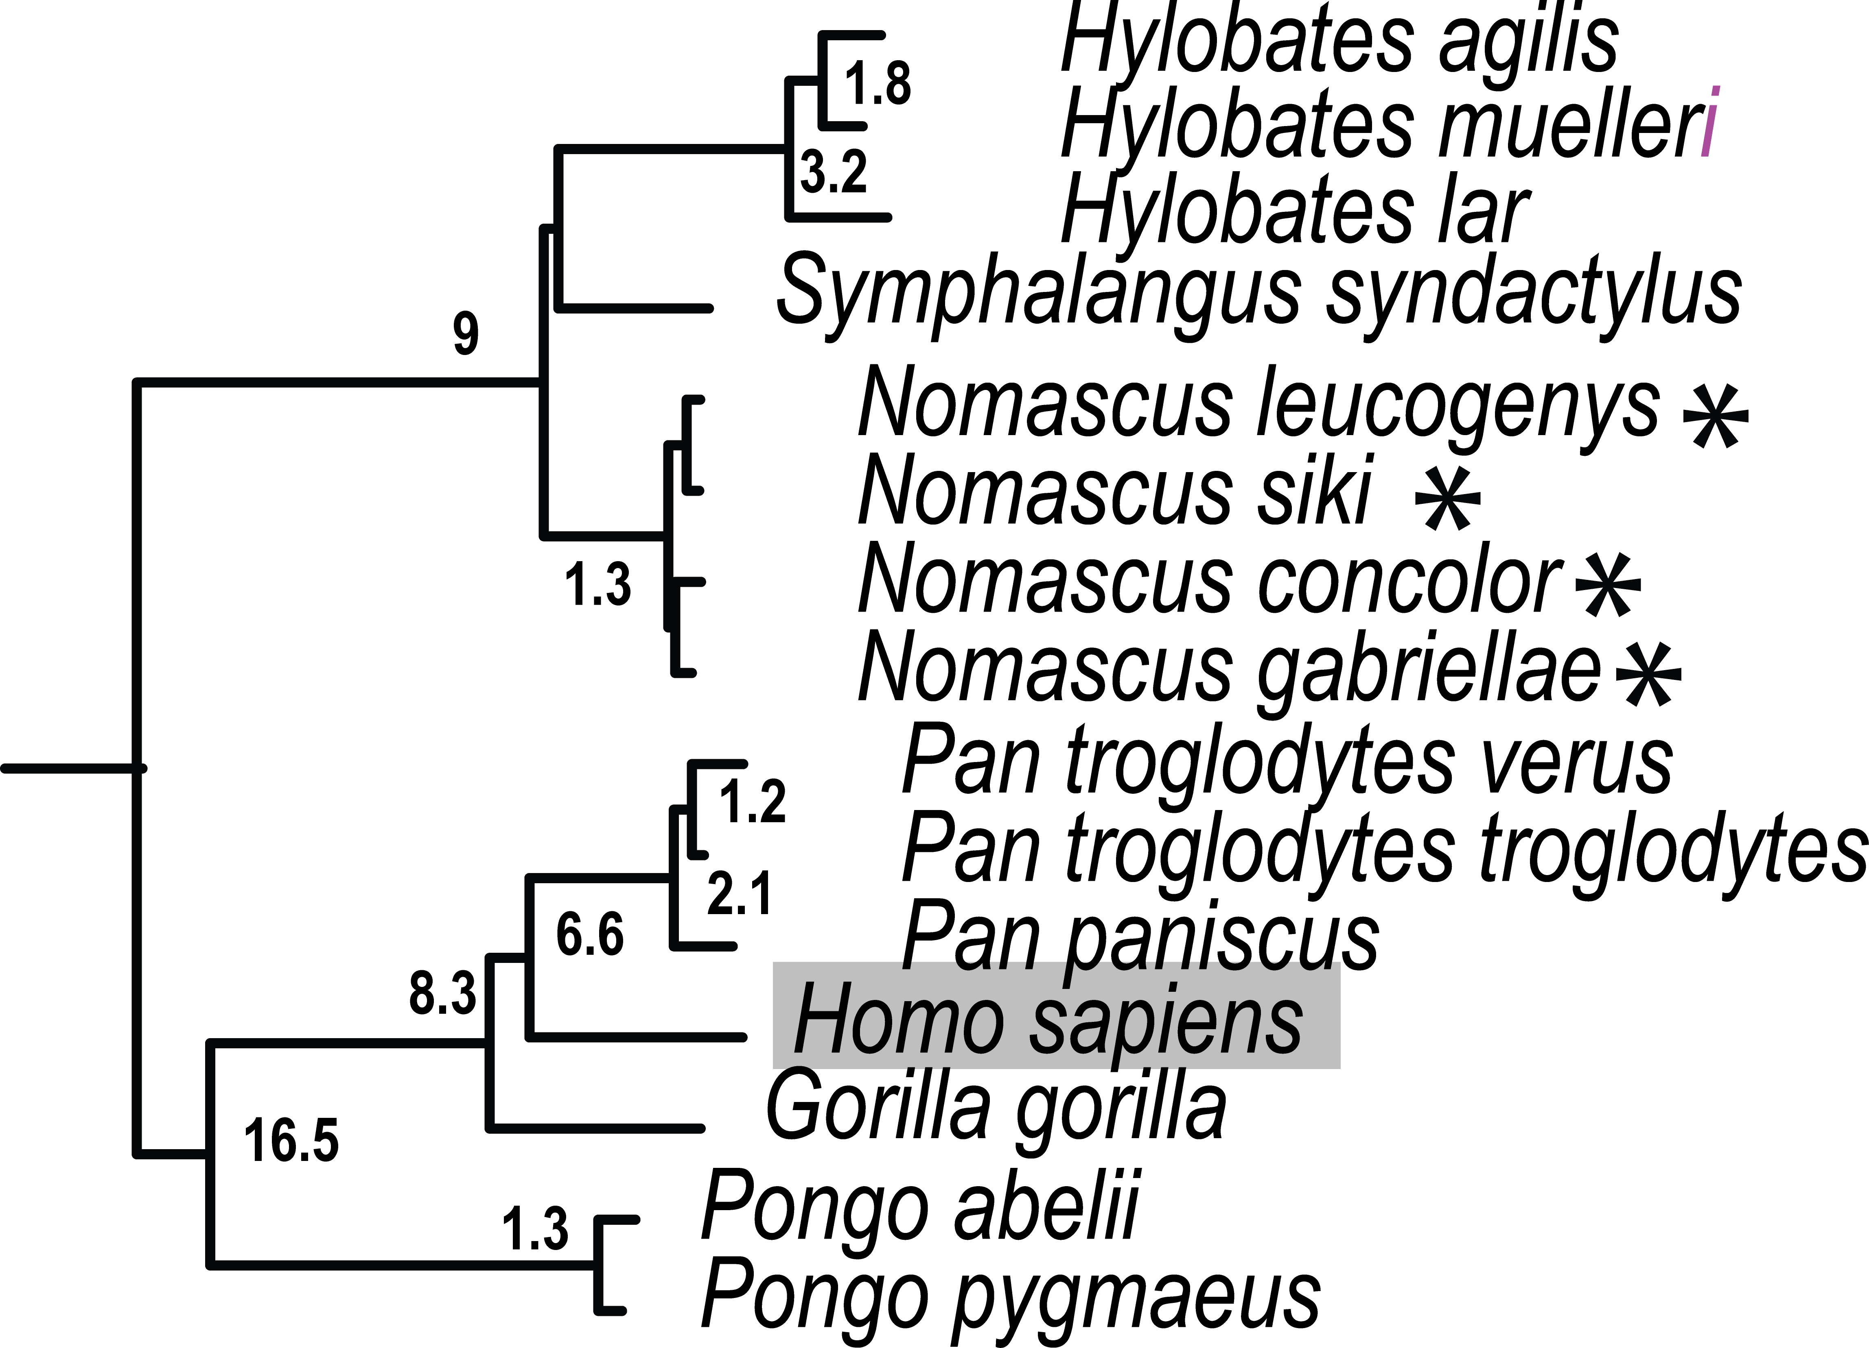
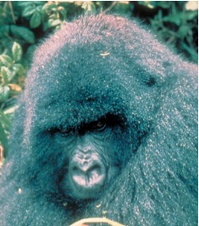
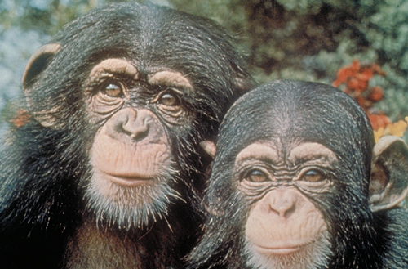
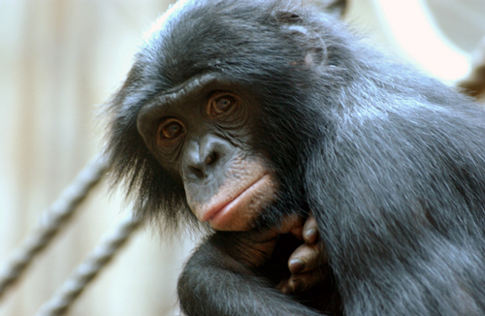
Hominoidea: Great Apes, Human, Gibbons
Hylobatidae:
Siamang, gibbon, hoolock
Exceptional rates of chromosome re-arrangement.
Each of 4 genera defined by different numbers of chromosomes.
Diverged rapidly from each other
Hominidae:
The largest primate Gorilla
Who is closest relative, Pan troglodytes or Pan paniscus?
20

Slide 17
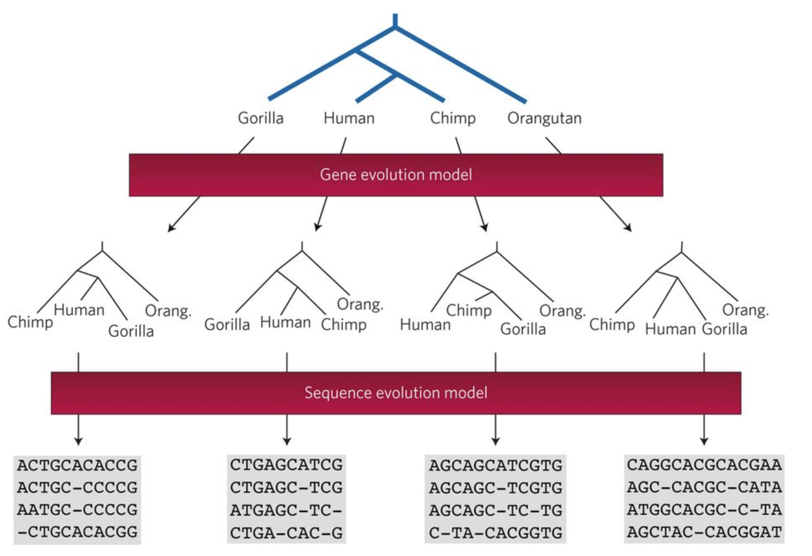
Gene Tree and Species Tree Discordance

Slide 18
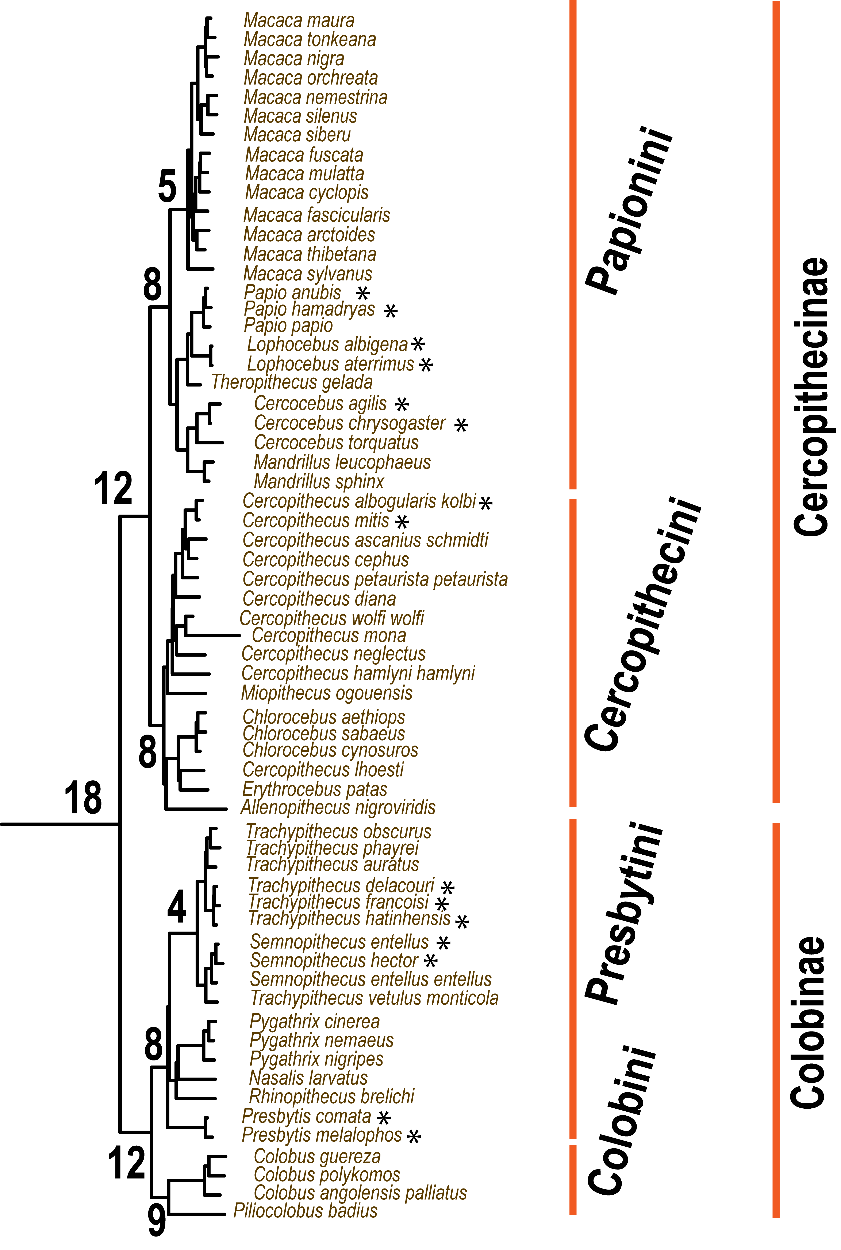
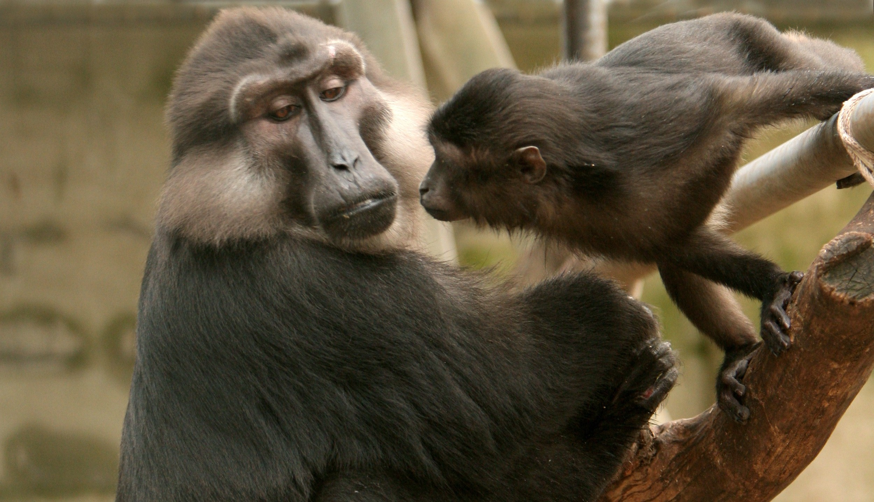
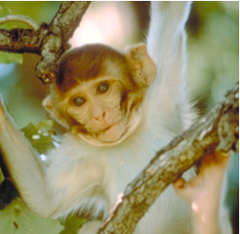
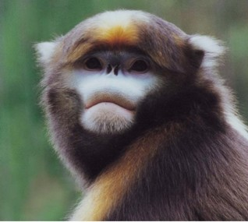
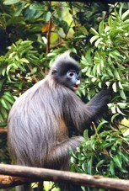
Cercopithecoidea: Old World Monkeys
Two Subfamilies
Cercopithecinae
macaques, baboons
Higher proportion of recent species (asterisk) < 1 MYA
Ongoing hybridization and introgression sympatric species
Colobinae:
Digestive adaptation to arboreal leaf eating existence
Asian and African tribes
Taxonomic revision of Trachypithecus, Presbytis, Semnopithecus

Slide 19
Considerations in Bacteria Gene Trees and Species Trees
Phylogenomics based on ‘core genome’
Gene acquisition, deletion, repeat cycle over time
Role of plasmid Hypervariable regions in genome (e.g. chlamydia example)
Unique genes often have vital function in adaptation and host-specificity
Rates of horizontal gene transfer unknown over time.

Slide 20
Plasticity zone in Chlamydia psittaci linked with host-pathogen interactions
Notes:
.

Slide 21
Bacteria Phylogenomics-Recombination

Slide 22
Gene Gain and Loss with Pathogen Evolution
Alan Mcnally et al 2016. Add, stir, reduce: Yersinia species as a model for pathogen evolution. Nature Reviews 14:177-190

Slide 23
Lentivirus Phylogeny and Genome Architecture

Slide 24
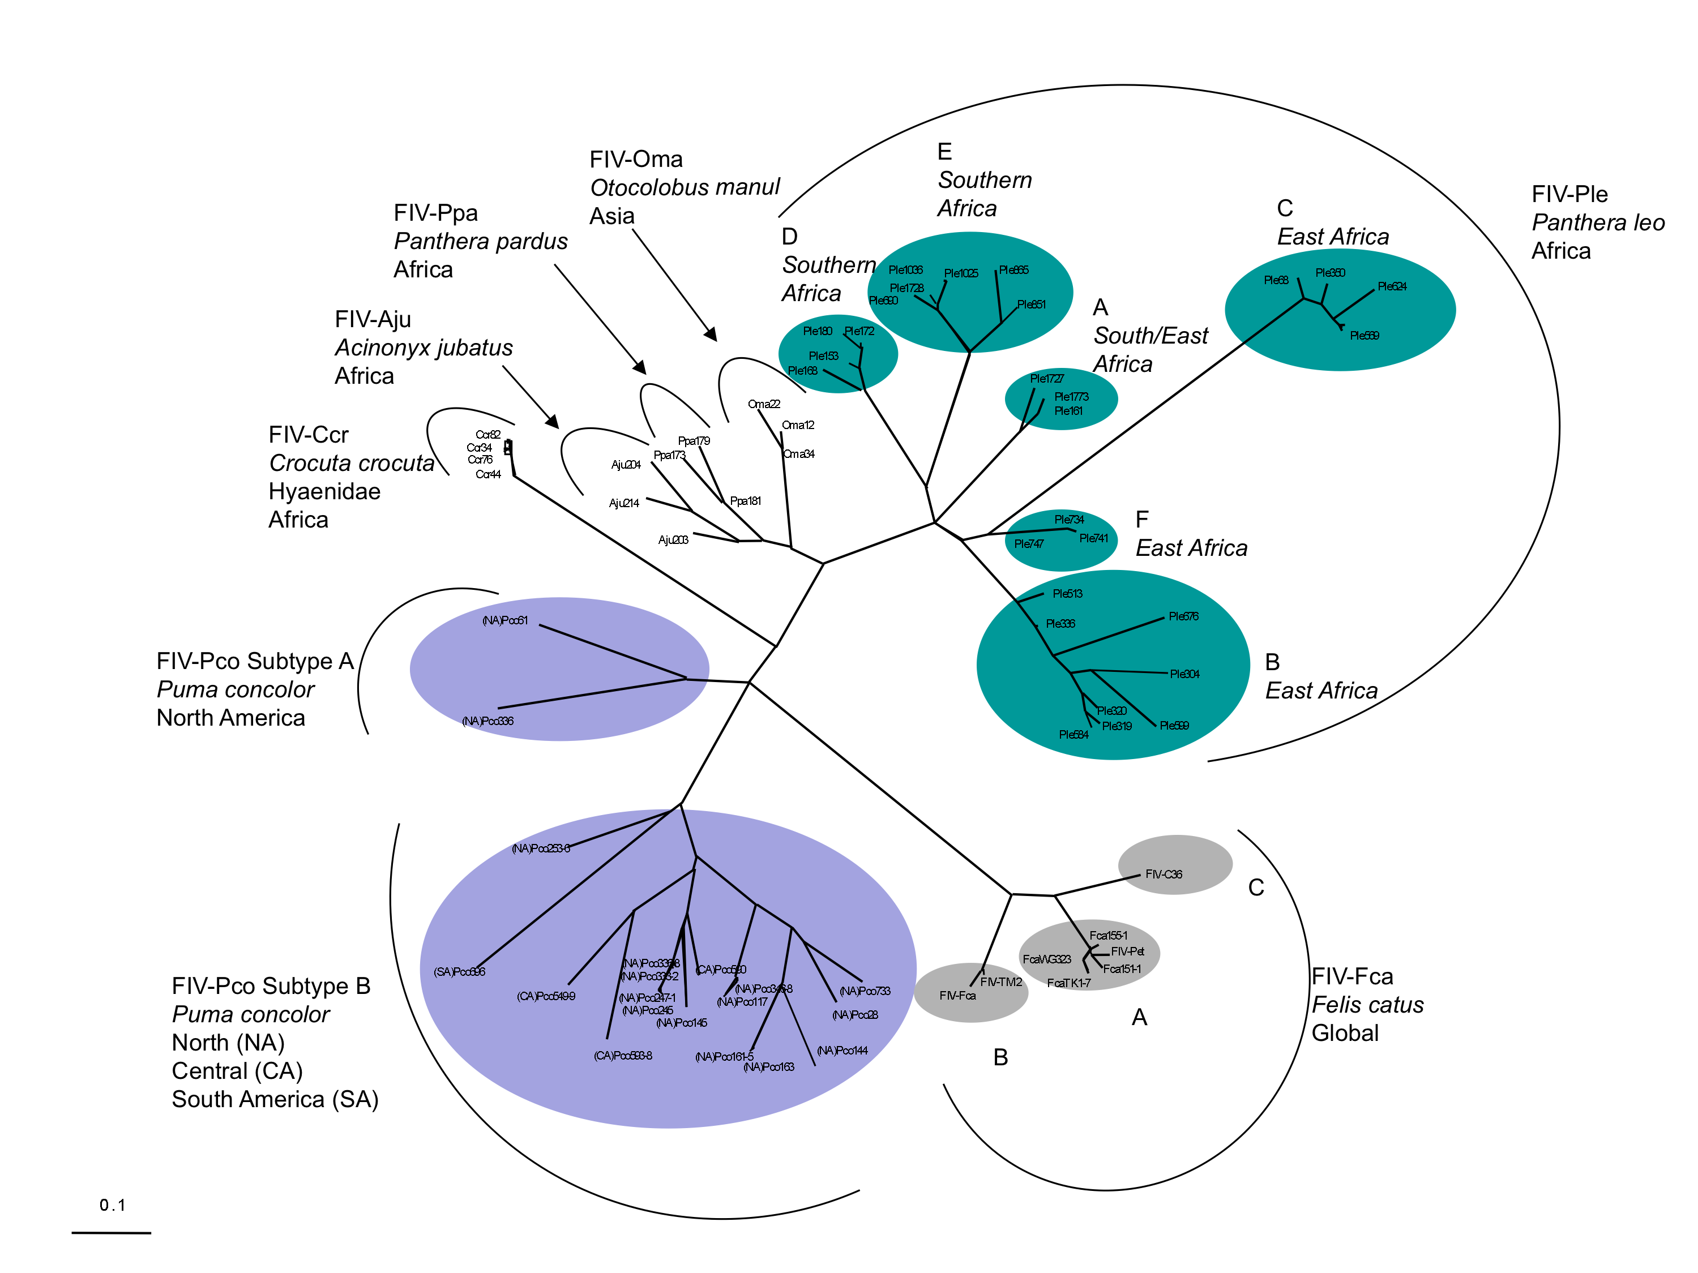
RT-Pol

